Slide 1
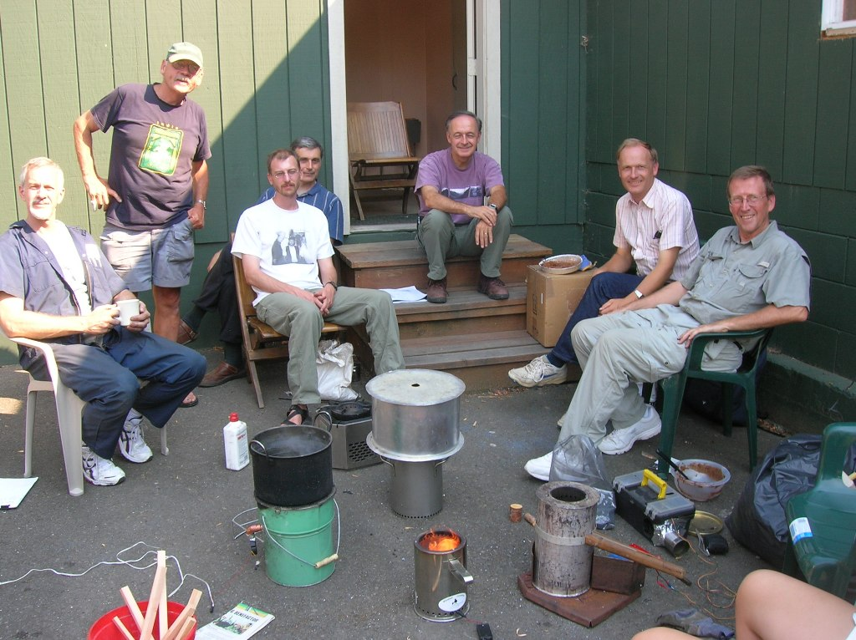
Dale Andreatta, Damon Ogle, Penn Taylor, Peter Chabarek, Bill Martin, Paul van der Sluis and Paul Anderson

Slide 2
Aprovecho Side Feed, BP OORJA, Philips, Tom Reed’s Woodgas, and Paul Anderson Stove

